Slide 1
AIRCRAFT SOS

Slide 2
Pages of content
1.Abstract 2. Introduction 3. Project Aim and Objectives 4. Technology to be Used 5. Functionality 6. Unique Features 7. Log In Page
8. ATC Portal

Slide 3
Abstract
Aircraft SOS is a comprehensive software project designed to efficiently and accurately track air flight data in the event of incidents such as airplane crashes. With the increasing complexity of air traffic and the critical need for timely response and analysis in the face of emergencies, it serves as an indispensable tool for aviation authorities, airlines, emergency responders, and investigators.

Slide 4
Project Aim and Objectives
Real-time Monitoring: Aircraft SOS continuously monitors flight trajectories, altitude, speed, and other relevant parameters to detect abnormal behaviors or deviations from standard operating procedures.
Incident Detection and Alerting: Upon detecting any unusual activity or potential incidents such as rapid altitude changes, sudden course deviations, or loss of communication, Aircraft SOS triggers immediate alerts to designated stakeholders for swift response and intervention.
Data Visualization and Analysis: Aircraft SOS offers intuitive visualization tools and customizable dashboards for analyzing flight data, enabling users to identify patterns, trends, and critical insights that aid in post-incident investigations and safety enhancements.
Historical Data Repository: Aircraft SOS maintains a comprehensive repository of historical flight data, incident reports, and analysis findings, facilitating trend analysis, regulatory compliance, and continuous improvement of aviation safety standards.

Slide 5
Technologies Used
We used MERN as a whole for this project.
Frontend–React Js, Material UI(React Library), Leaflet-React (Map Library), Axios (For API request), Chart Js (for Visualizing Data)
Backend – Express Js, Node Js, JWT (Json Web Token), Bcrypt (For Hashing Password), Mongoose (To connect with MonogDB)
Database – MongoDB

Slide 6
Functionality
Our Project is aimed towards rescuing aircrafts:
We have two main portals for different purposes.
Air Traffic Control - They track the aircraft and in case of an emergency, they send a response to the database / server.
Emergency Responders – They will investigate the incident location according to the data they received by the ATC in the server / Database.

Slide 7
Unique Features
Data Security – Validation on Login page, Data Hashing, Authorization / Authentication, Protected Routes
One of a kind – Haven’t been able to find any other project like this on the internet be it reddit, GitHub, Stack Overflow etc.
Instant Response – After an incident, there is an instant response to the server which further goes to the emergency services which in turn minimizes the search time hence saving lives and cost.

Slide 8
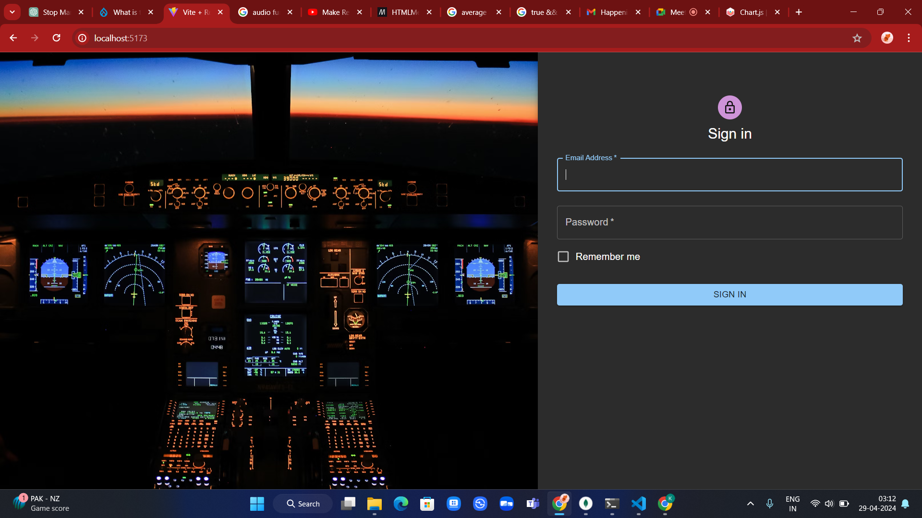
Log In Page

Slide 9
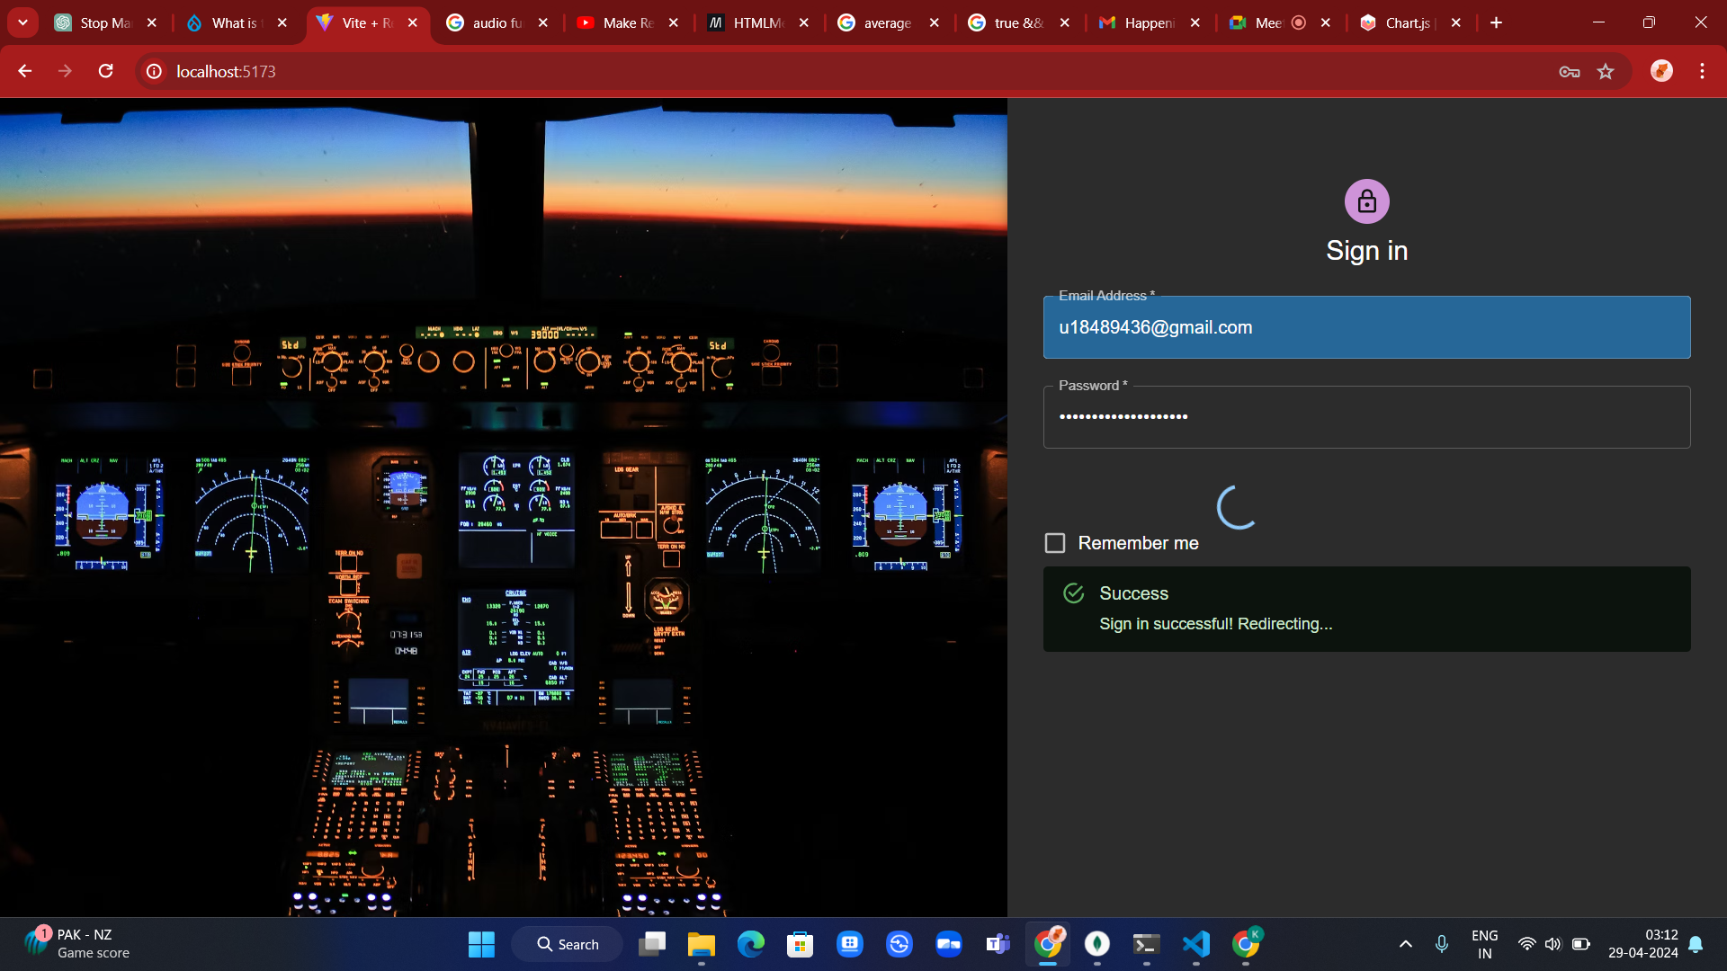
Log In Page

Slide 10
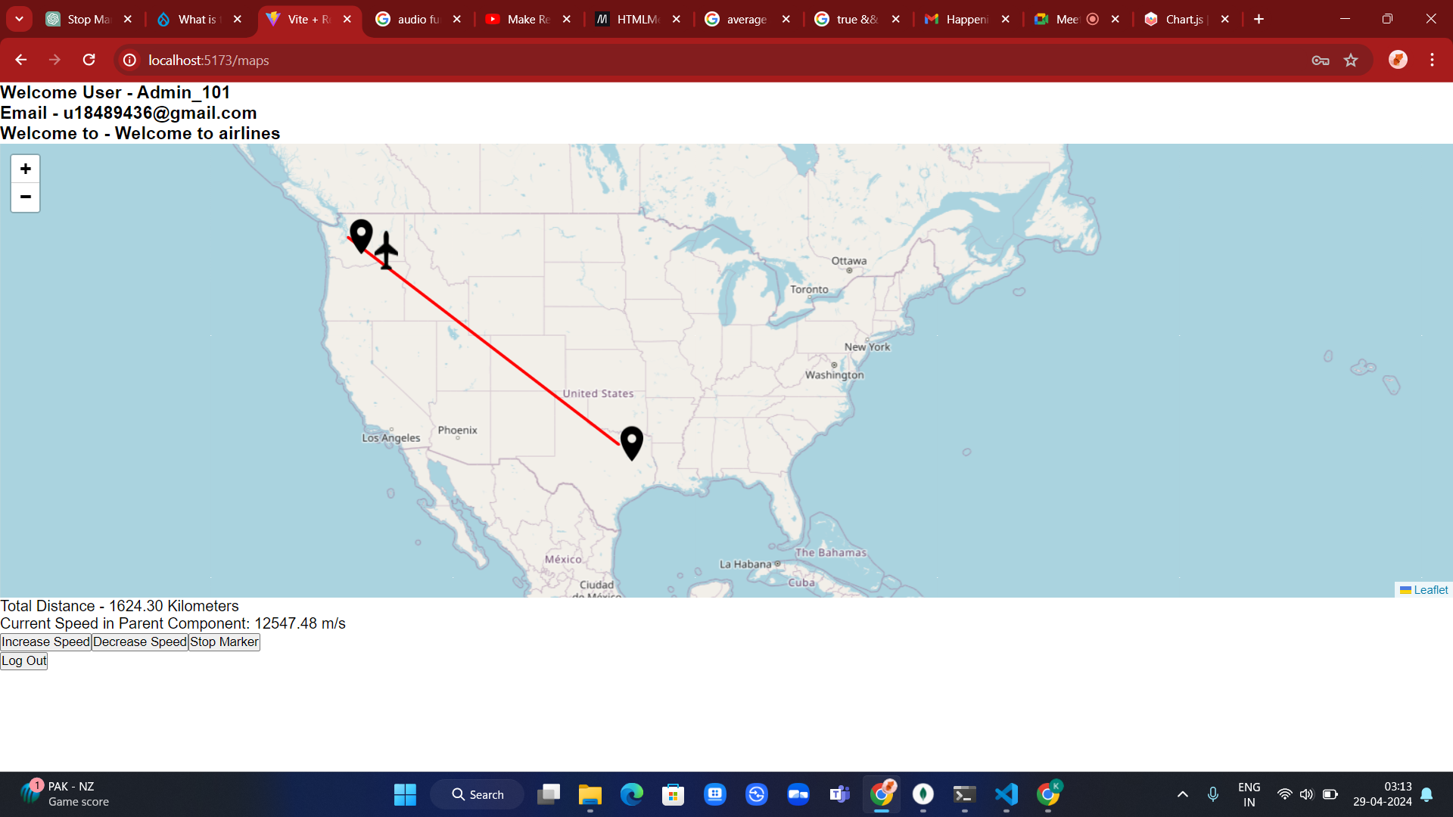
Air Traffic Control Portal

Slide 11
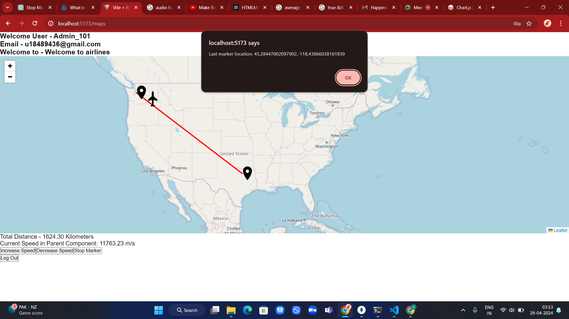
Air Traffic Control Portal

Slide 12
Thank You
Submitted by:
Karan Arora – 2210997111
Kartik Vashisht – 2210997114
Garima Jain - 2210997080

